Slide 1
What is Air Pollution?
Notes:
As a result of participating in this session, students will be able to:
REMEMBER what air pollution is
UNDERSTAND what causes air pollution
EXPLAIN the effects of air pollution on the planet

Slide 2
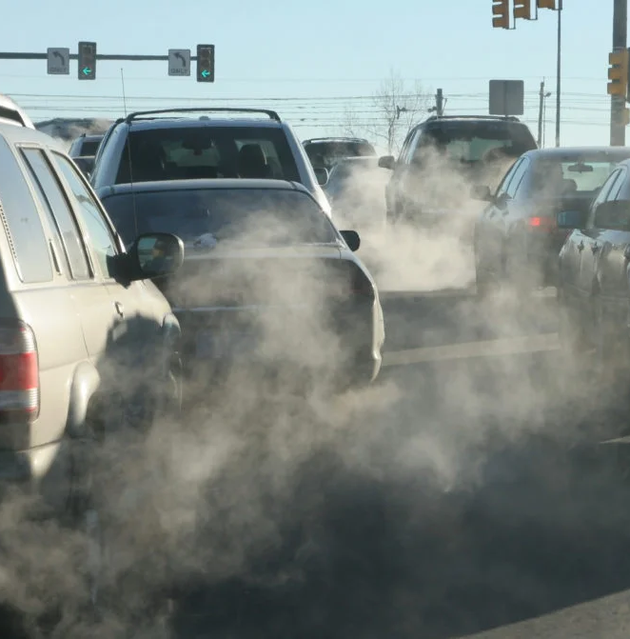
What do you know about air pollution?
Notes:
Introduction / Do Now Task: 10 mins
Ask students to work in small groups, thinking about what they know already about air pollution and gathering their thoughts as notes.
Students should use a format they are comfortable with, such as a spider chart in the activity sheet provided.
Take feedback to share a few of the key points. Ask students to retain their notes for later on in the lesson.

Slide 3
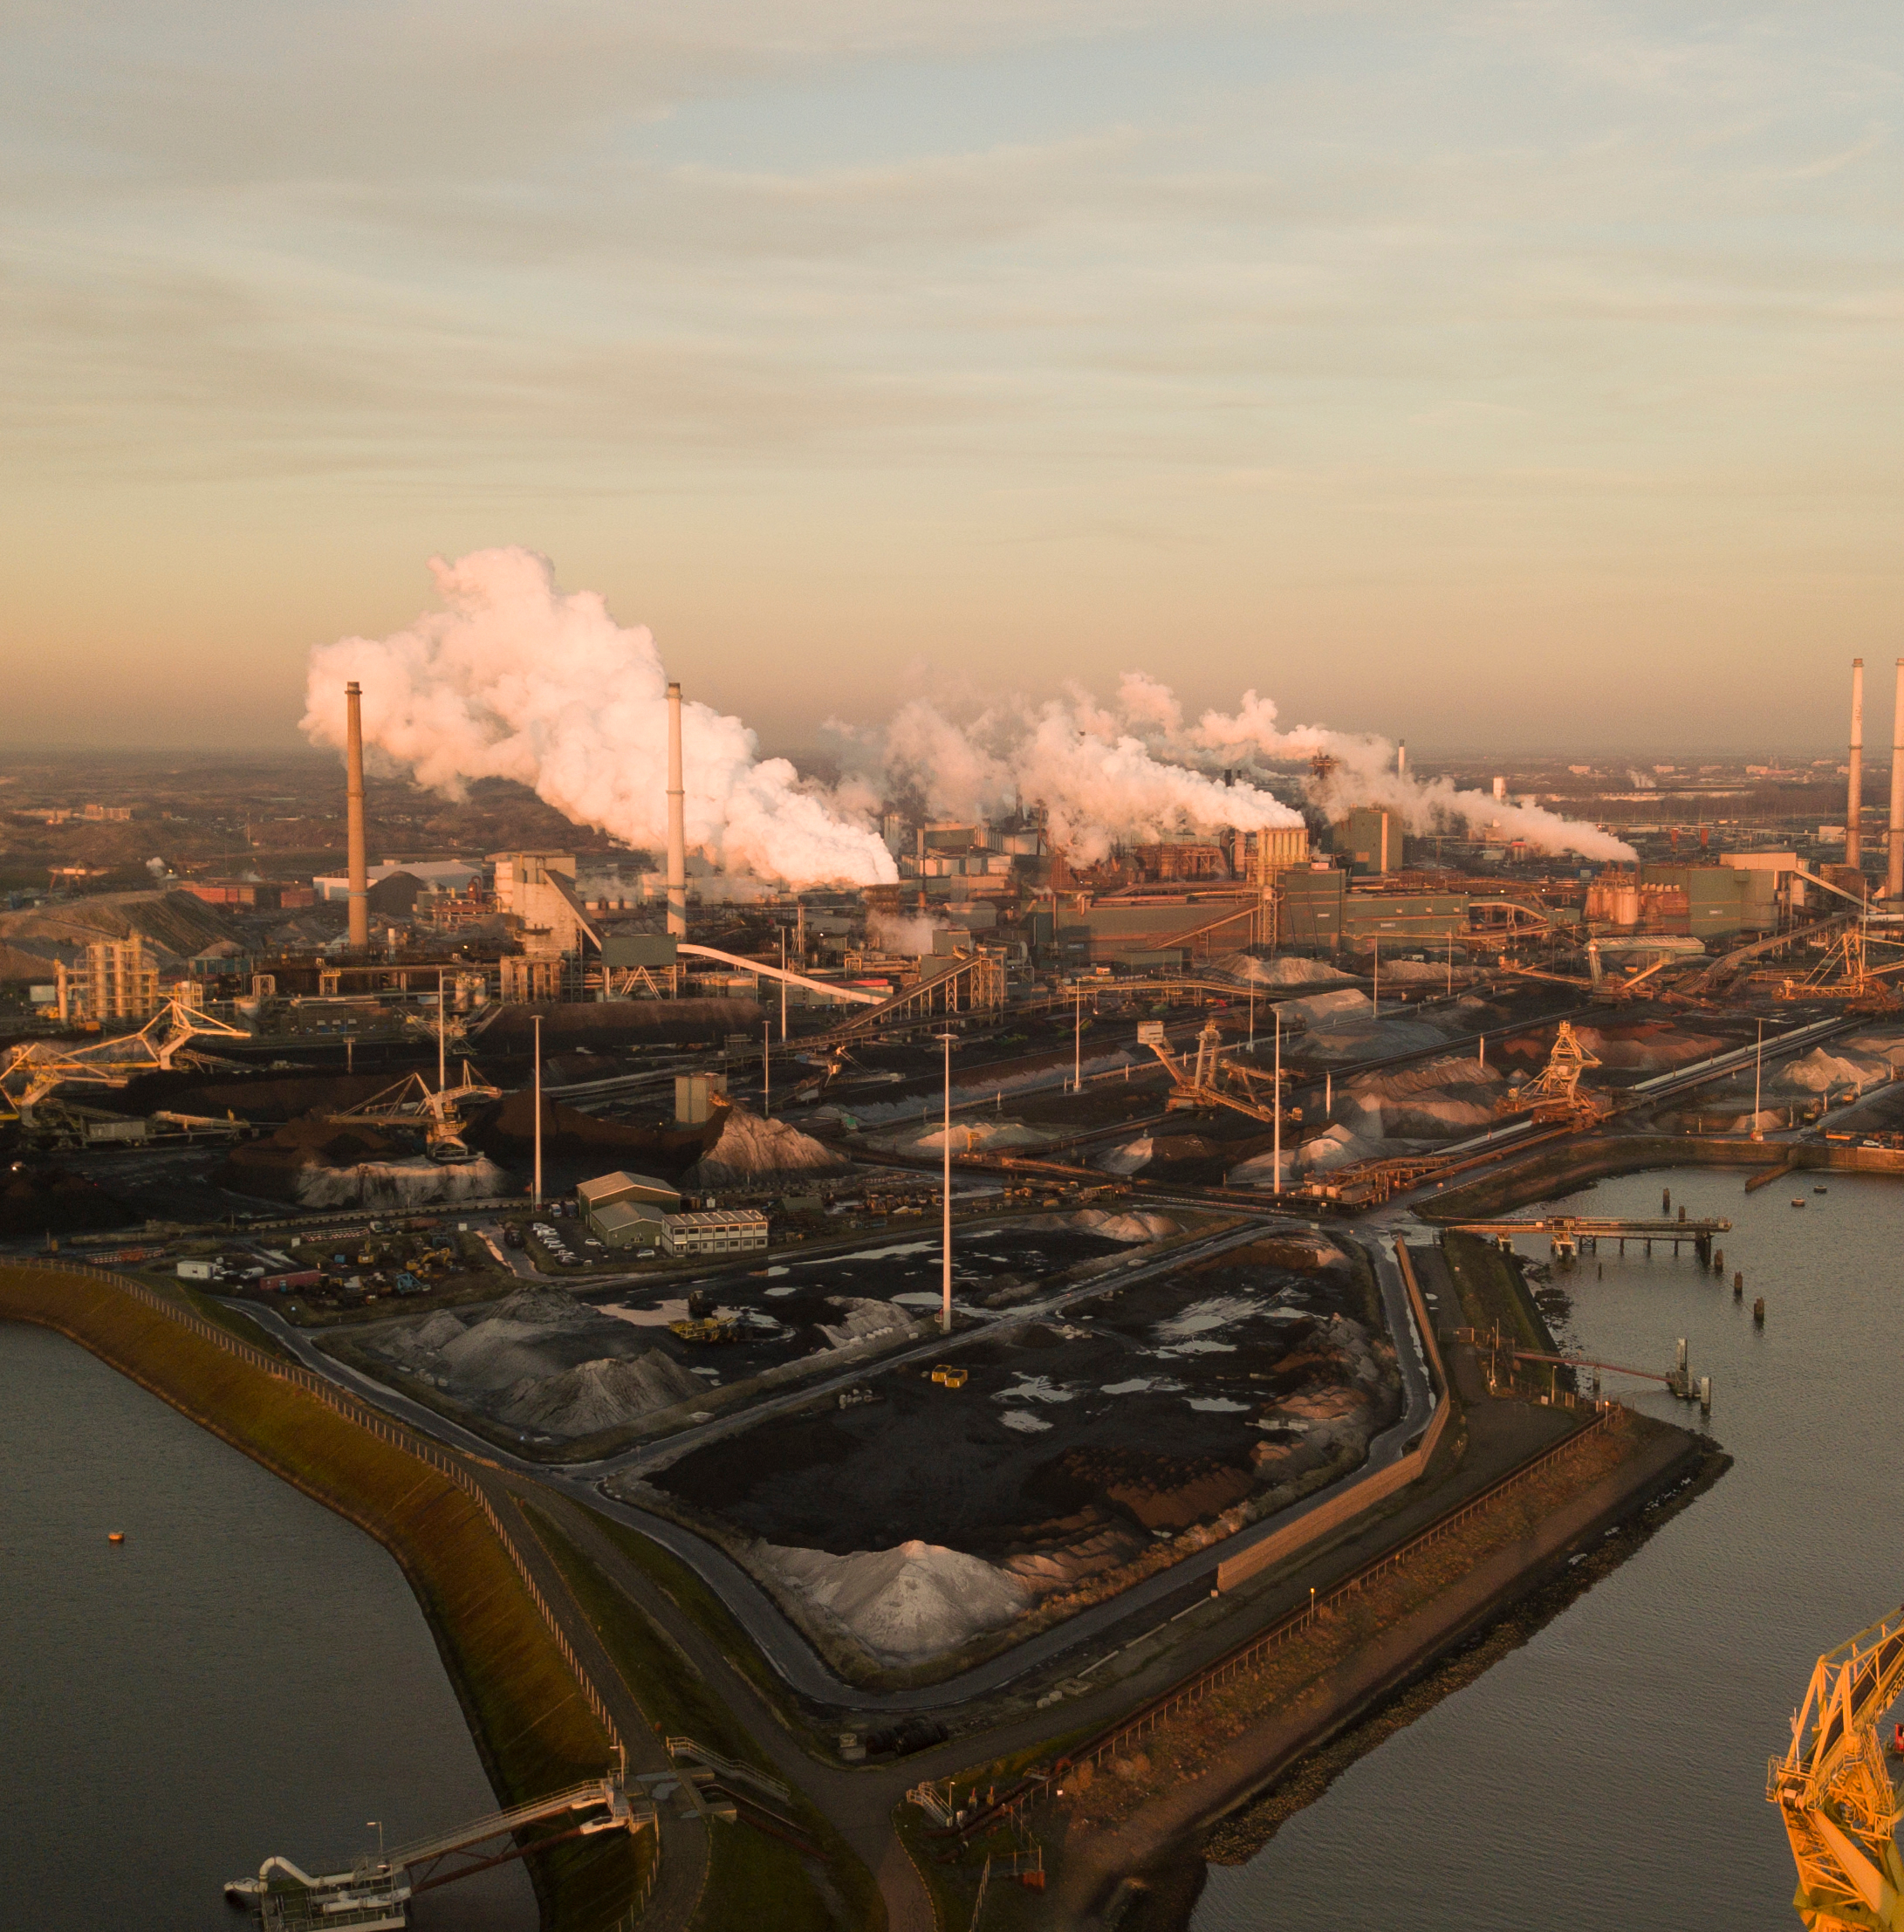
Air Pollution
What is air pollution?
What are the causes of air pollution?
What are the effects of air pollution, on the human body?
What are the effects of air pollution, on the atmosphere?
What can we do to control air pollution levels?
Notes:
Starter Task: 20 mins
Explain to students that you are going to show them a video and that they need to gather information whilst it is playing. Before showing them the video display the questions you want them to explore.:
What is air pollution?
What are the causes of air pollution?
What are the effects on the human body?
What are the effects on the atmosphere?
What can we do to control air pollution levels?
It may be useful to either pause the video at points or to show it twice.
Take feedback and display key points (these are needed for the next task); address any misconceptions.

Slide 4
Air Pollution Research
In groups either:
Explain your point further
Or
Provide an example
And provide a sentence summary of a key point to share with the class.
Notes:
Main Task: 20 mins
Allocate points from the previous task to small groups of students to research further, so that (ideally) each group has a different task. Explain that their research should enable them to either:
Explain the point further
or
Provide an example (or different example)
They could use textbooks, prior knowledge or the internet, such as:
Air pollutants - The atmosphere - AQA Synergy - GCSE Combined Science Revision - AQA Synergy - BBC Bitesize
Students should compile notes/summaries of their research findings, and how they have answered the point assigned to their group.
Go round the room, asking for a one sentence summary of a key point from their work.

Slide 5
Any more ideas?
Notes:
Plenary: 10 mins
Using a different colour pen, ask students to now add more ideas about air pollution to the notes they created in the ‘Do Now Task’.
Encourage students to draw upon both what they found out and also what other class members shared.
Ask students to volunteer examples of additions or select students to share.

