Slide 1
Detecting Air Pollution
Notes:
As a result of participating in this session, students will be able to:
RECALL information about the factors affecting air pollution
INTERPRET data relating to local levels of air pollution
SUGGEST how the residents of their locality are affected by air pollution

Slide 2

How can Scientists Detect Air Pollution?
Notes:
Introduction / Do Now Task: 10 mins
Remind students that in the previous lesson, they looked at ideas about particulates and some simple ways of gathering data about where they exist.
Point out also that in lesson 1 they looked at different forms of pollution and that as well as particulates there are also, in air pollution, other substances such as gases.
Ask students to suggest how scientists might be able to detect air pollution.
Take feedback on ideas and draw out that there are various ways such as using gas detectors, studying tiny particles that have settled out and looking for patterns in the incidence of respiratory diseases.

Slide 3
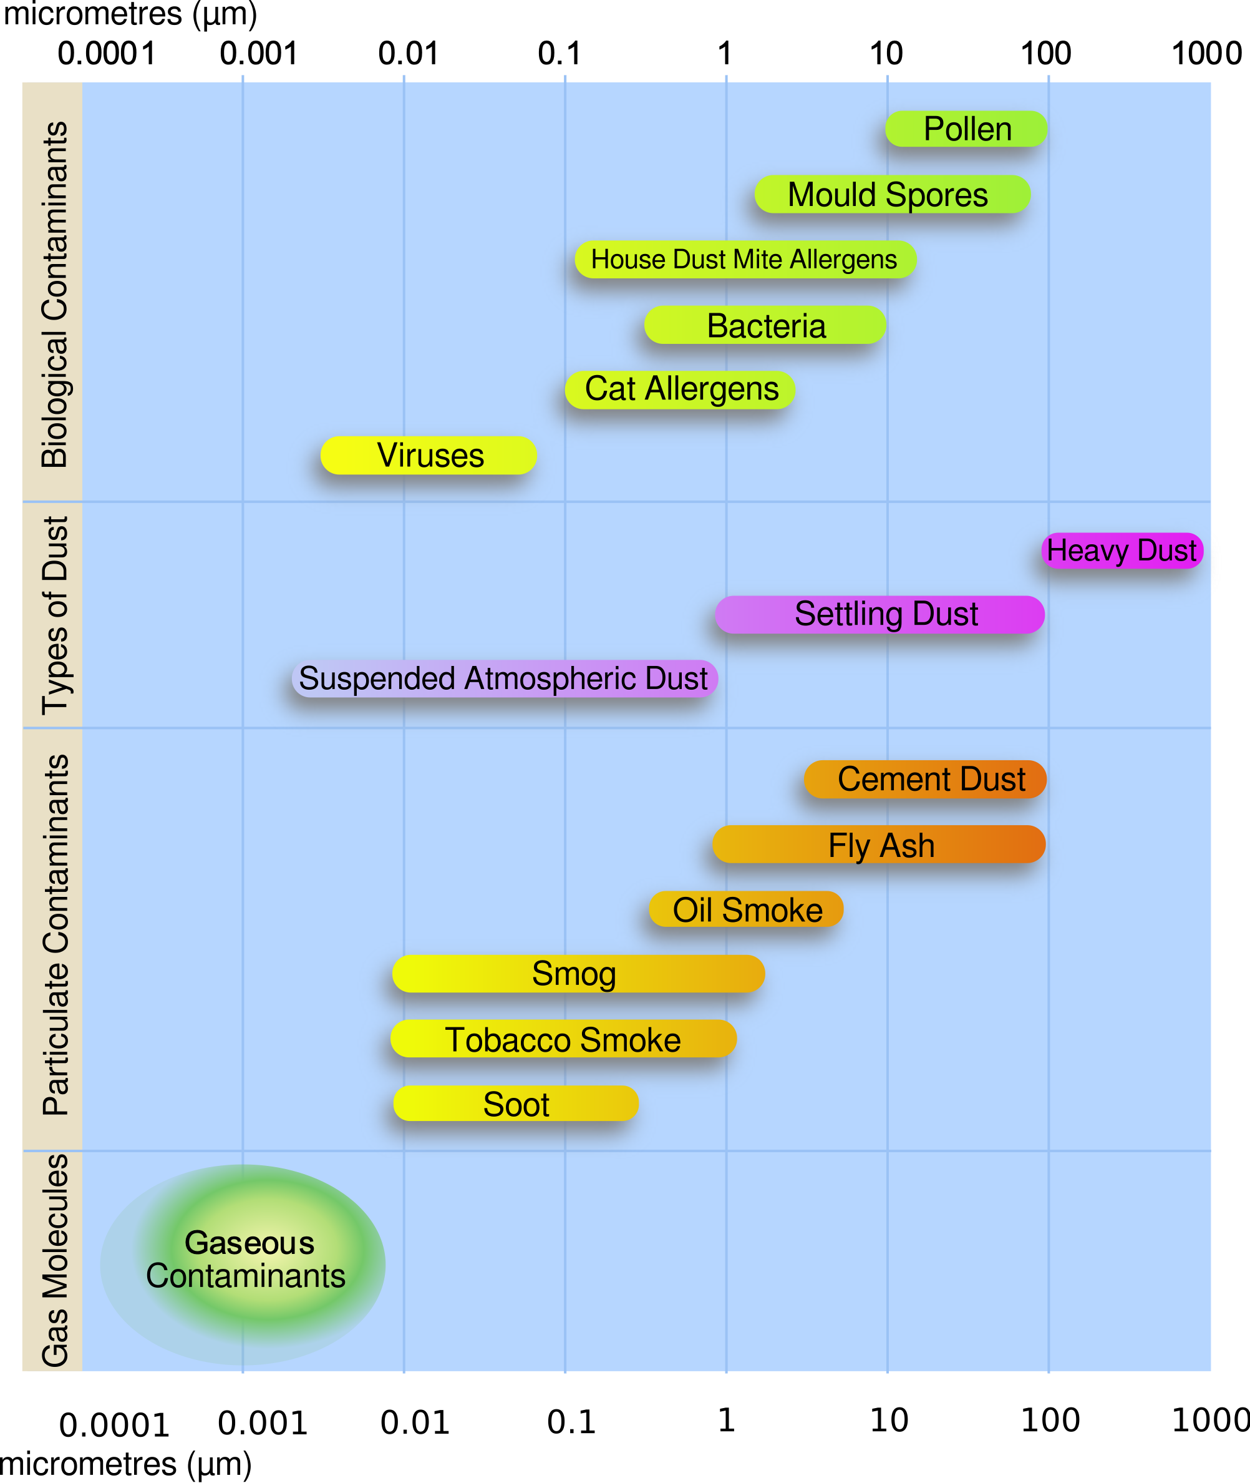
What can you recall?
Where are particulates more present?
What are the health risks of particulates?
Notes:
Starter Task: 10 mins
Remind students that one of the forms of air pollution is particulates, which are tiny particles released from the burning of hydrocarbons, such as in petrol and diesel engines. Show graphic of particulates and explain the units that are used to measure these.
Then explain that particulates can cause respiratory problems, such as irritation of the lungs and reduced effectiveness of gaseous exchange.
Ask students to recall and share ideas about where particulates seemed to be more present, e.g. in relation to distance from a road and height above ground.
Now display a map of the area and ask students to suggest whereabouts they think that the incidence of particulates would be lower and where it would be higher (Following Slide)

Slide 4
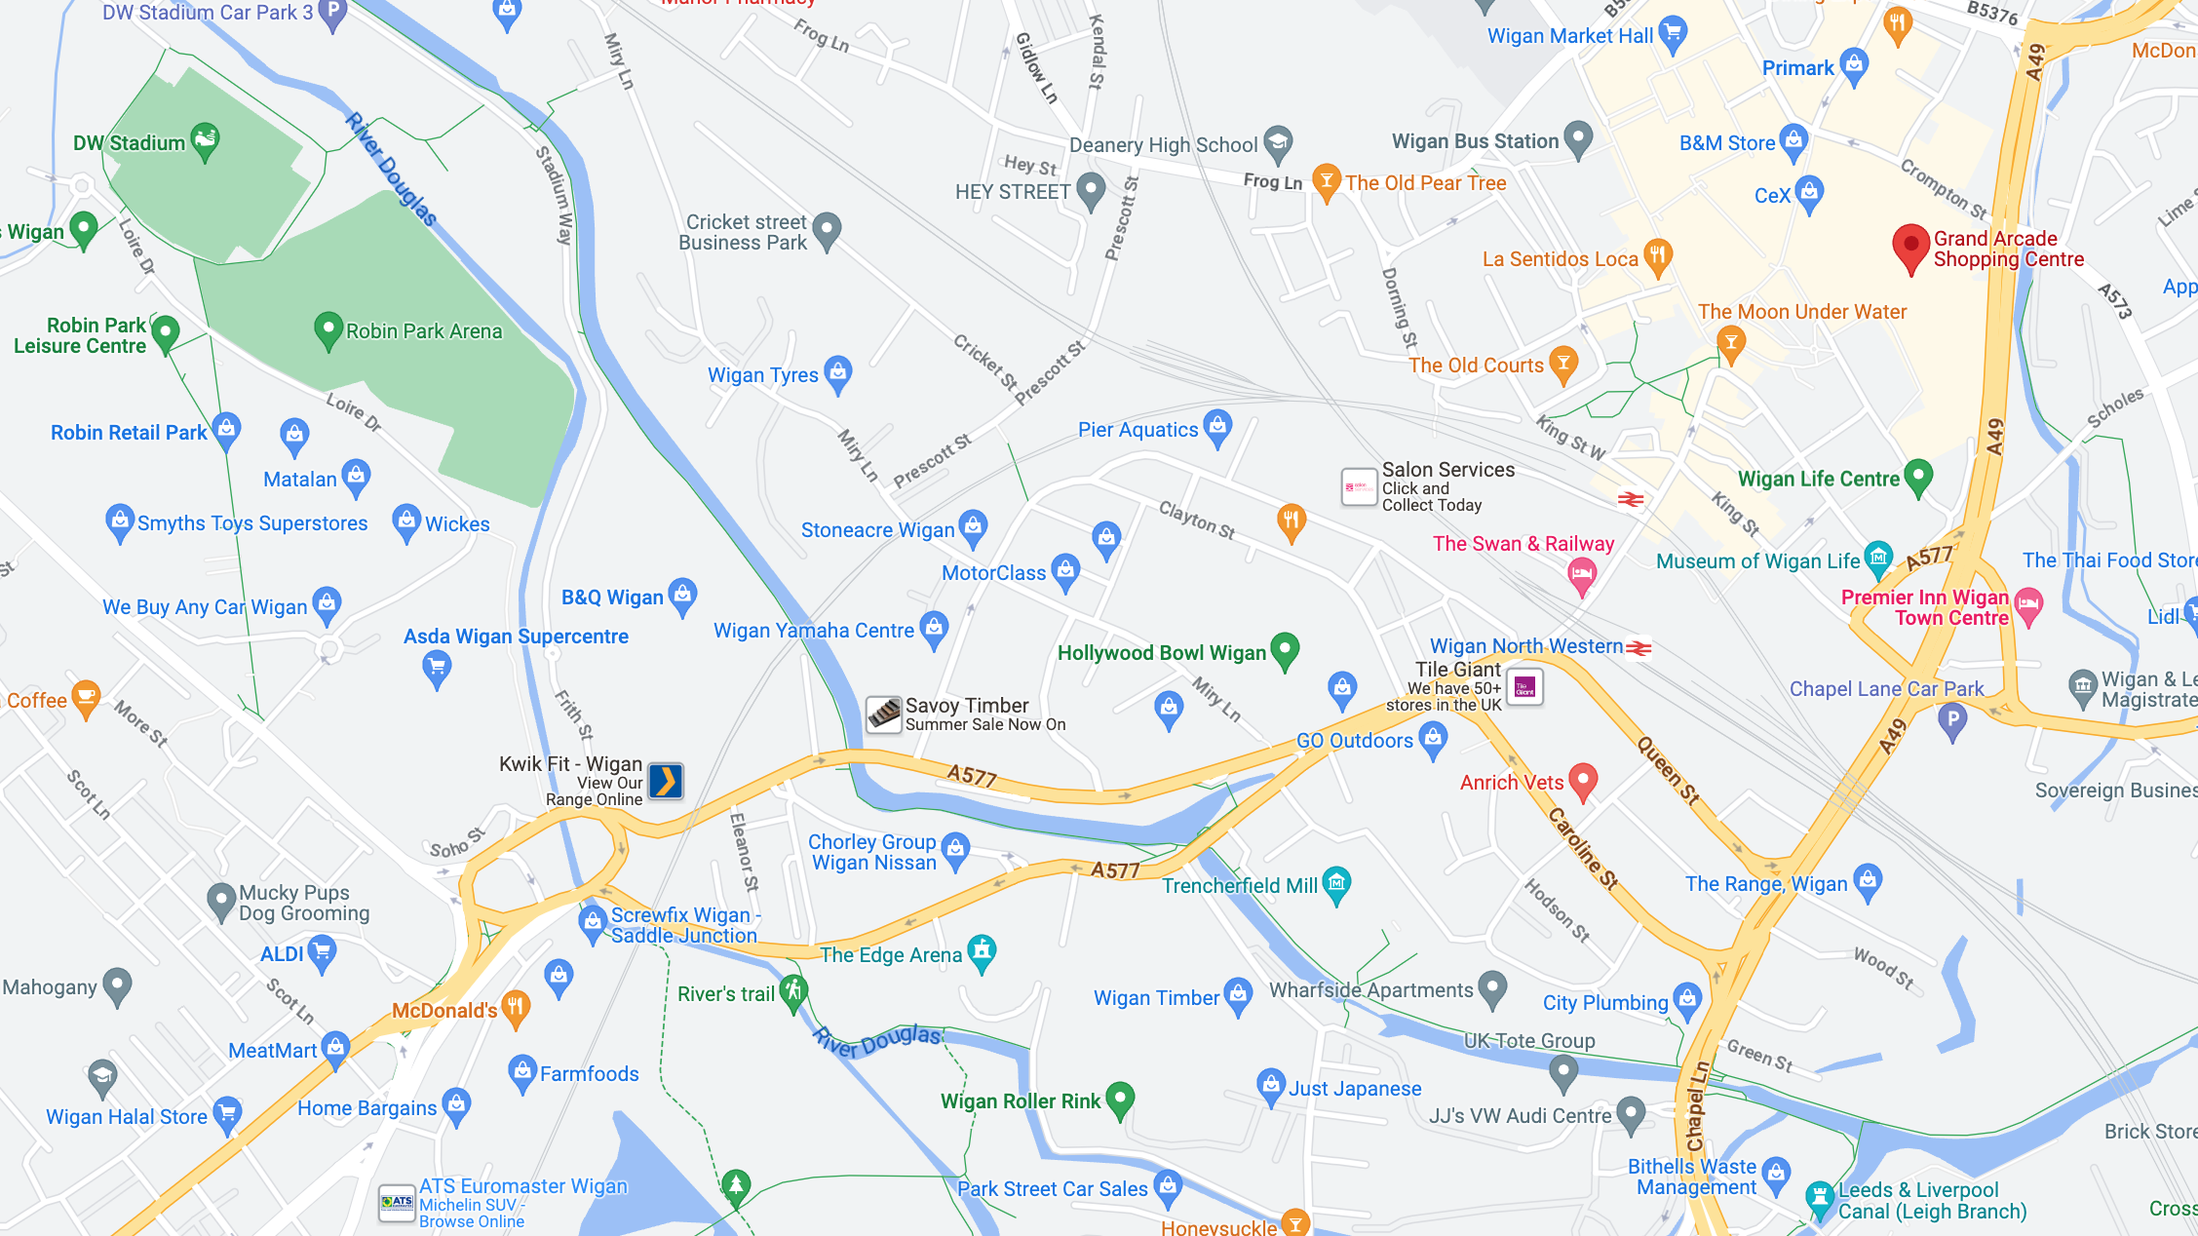
Notes:
Now display a map of the area and ask students to suggest whereabouts they think that the incidence of particulates would be lower and where it would be higher

Slide 5
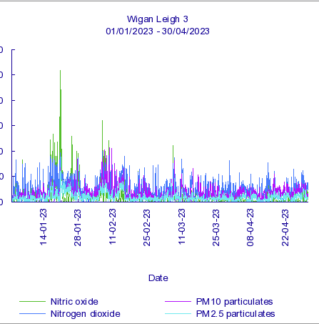
Air Pollution Data
What does the data show?
Why might the data vary at each different collection point?
Notes:
Main Task 1: 15 mins
Show students the sample data from the London Borough of Hillingdon and explain how it is presented.
Explain that it is historical data and ask for suggestions about what it shows and why the data might vary according to the collection point.
Draw out key points about what the data shows.

Slide 6
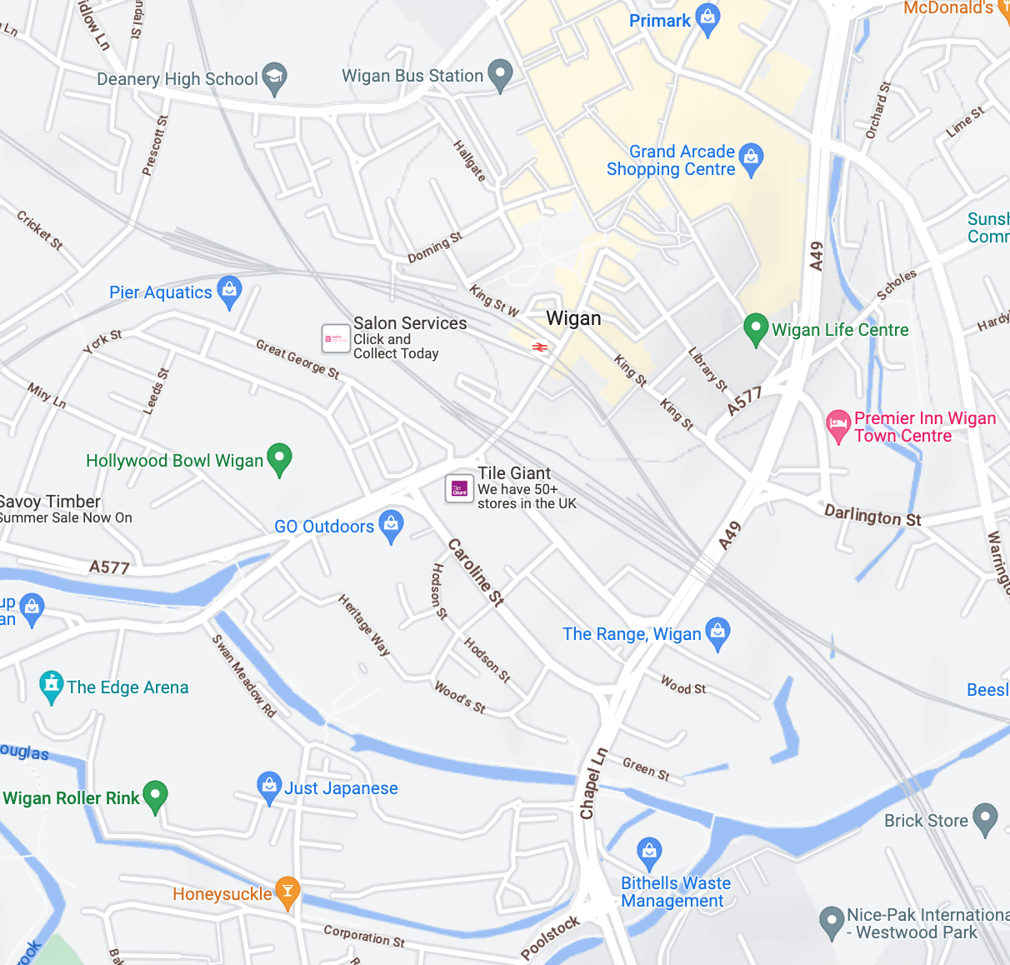
Air Pollution in Wigan and Leigh
Analyse the air quality data and compare the four locations.
What does the data show?
Notes:
Main Task 2: 15 mins
Now show students the live data from Wigan and Leigh and also provide them with a map to show the geographical location of the data collection points.
Ask students to work in small groups to analyse the data, compare it with the locations and to suggest what the data shows.
Each group should make a list of the conclusions that can be drawn from the data.
Go round the room asking each group to offer one key point, trying to avoid any repetition from previous groups.

Slide 7
Air Pollution in Wigan and Leigh
Analyse the air quality data and compare the four locations.
What does the data show?

Slide 8

In Wigan and Leigh, where is it healthier to live?
Notes:
Plenary: 10 mins
Ask students what the data shows about whereabouts in Wigan and Leigh is it healthier to live with respect to air pollution levels?

