Slide 1
How is Climate Change Affecting Wigan and Leigh?
Notes:
As a result of participating in this lesson you will be able to:
CREATE a series of questions about climate change within local areas
APPLY knowledge of the local area, extreme weather and climate change to an exam-style question.

Slide 2
How do you think a changing climate could affect the Wigan and Leigh area over the next 25 years if we don't change our behaviours now?
Notes:
Introduction: 10 mins
Ask students to consider key points from this lesson and return to the overarching question about how climate change could affect the area if we didn't change our behaviours now.
Then ask students to write down three key ideas they have learned from the work they have done and take sample responses.
Draw out ideas such as:
Rising water levels
Extreme storms
Higher temperatures
Disrupted food supplies as agriculture in other parts of the world is affected
Wildfires.

Slide 3
How do you think a changing climate could affect the Wigan and Leigh area over the next 25 years?
Group discussion
Notes:
Starter: 15 mins
Taking ideas developed in the previous task, allocate one per group of around 3-4 students, ensuring each group of students has a different idea to work on.
Ask the groups to develop their response in more details. This will require students to do some research to find out more.
Advise students they should work towards developing three bullet points. Each group to display their bullet points on a large dry wipe board or A3 sheet of paper so that the class can clearly see points.

Slide 4
What are your 3 points?
1.
2.
3.

Slide 5
How do you think a changing climate could affect the Wigan and Leigh area over the next 25 years?
Marketplace activity
Notes:
Main Task 1: 15 mins
The ideas developed in the first task should be put on display around the classroom.
Nominate one person from your group to stay next to your ideas, the other students within the group should go around the classroom, looking at other group’s work and suggesting additional ideas.

Slide 6
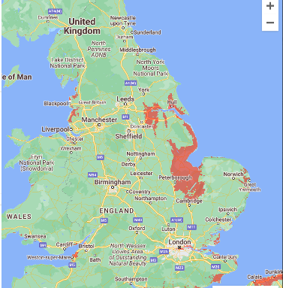
Effects of Air Pollution
Worsening air pollution across Wigan and Leigh, will not only impact the local area, but will also have a knock-on effect nationally, and globally.
One example of this is rising sea levels, as shown by the map.
Although Wigan and Leigh will be not directly impacted by rising sea levels, the area will experience in direct effects.
Can you name any impacts the area
may experience?
Notes:
Main Task 2: 10 mins
Introduce the idea that it isn’t only what is happening in the immediate area that will affect people living in Wigan and Leigh.
Use Climate Central map function to show the effect of rising sea levels. This will show that, unlike some parts of the UK, the area around Wigan would still be above sea level, even if there was a significant rise.
Ask students to suggest why there would still be clear implications for the area though.
Draw out ideas such as:
displaced people from other areas
negative impact on agricultural areas
disruption to critical infrastructure in areas such as London

Slide 7


Climate Change Warning Poster
Notes:
Main Task 2: 10 mins
Encourage lower-ability students to design a Climate Change Warning Poster for display in public areas like schools, libraries, and sports centres.
The A4 poster should illustrate the potential impact of climate change on our surroundings and emphasise how simple actions by everyone can contribute to the solution.

Slide 8
What have you learned today?
How is Climate Change Affecting Wigan and Leigh?
Notes:
Plenary: 10 mins
Ask students to consider key points from this lesson and return to the overarching question about how climate change will affect the area.
Then ask students to write down three key ideas they have learned from the work they have done and take sample responses.

